Slide 1


Hardware Workshop
EE 104 | Lecturer: Dr. Pinku Ranjan | Lab Instructor: Dr. Sandesh Jain
Batch no.3 --> Group no. 8 Presents
U-Drain V-Charge
Wireless Charging station for electrical vehicle
Bhudev Bhanpuriya – 2023BEE012 , Sambodhi Roy – 2023BMS-027, Shubham Sharma –2023BEE032, Prince Agrawal- 2023BEE029

Slide 2
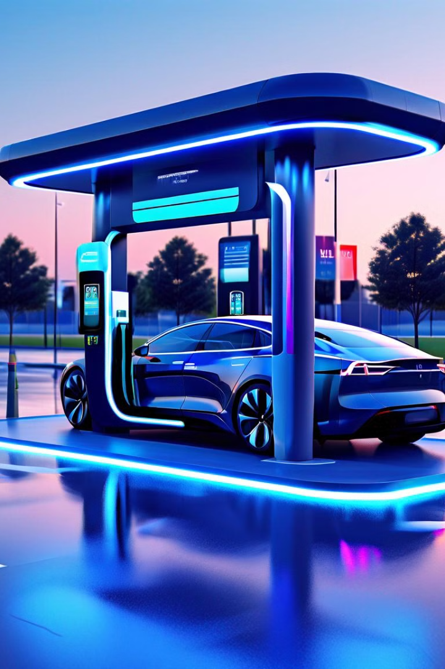
Wireless Electric Car Charging Station
The "Wireless Charging System for Electric Vehicles" project addresses the growing demand for efficient and convenient charging solutions in the electric vehicle (EV) industry. With the increasing adoption of electric vehicles, there is a need for advanced charging technologies that enhance user experience and contribute to the overall sustainability of transportation.

Slide 3
Introduction
The development of wireless charging systems for electric vehicles has gained significant momentum over the past decade. Part of this is based on the desire of cities to push away from petrol and diesel-powered vehicles to help provide cleaner cities, given the intense urbanization that is occurring globally, and partly because electric vehicles are becoming more efficient and cost competitive. With wireless charging systems properly integrated into vehicles, and situated strategically around a city as well as at owners’ homes there should be no need to ever plug in their vehicles. Drivers should simply park as usual over a coil placed on the ground or buried in it. However, adopting this technology also has the potential to solve several real and perceived problems.
Today, vehicles are charged at home or, in the case of fleets, at the owner’s place of business. Tomorrow, they’ll be charged in a variety of additional places, including at work, at the store, on the street and in places of interest. The provision of wireless electric vehicle charging points at these locations may increase employee/customer loyalty, attract new customers, and encourage wider adoption of wirelessly charged vehicles in larger population centers, thus reducing air pollution. Ideally, vehicles can be charged whenever and wherever they are parked and EV owners should not have to concern themselves with the grid connection, which will happen automatically.

Slide 4

Principle
The first person to theorize about “wireless” electrical energy transfer was Nicola Tesla in 1896. The operating principle is similar to that of a transformer and is based on the laws of magnetic induction. A primary circuit, called a transmitter, generates a time-varying magnetic field. A secondary circuit receives this field, called the receiver, which is connected to the device to be powered. The most important parameters to take into account are certainly the distance between the two circuits and their alignment. Poor alignment and a relatively large distance degrade performance and make energy transfer inefficient.

Slide 5
Components Used
Arduino
Power Source
Microcontroller platform , which ensure power management and will act as a communication interface and will do corresponding billing using IR sensors.
The battery is the power source for the vehicle, and the wireless charging system ensures it is kept charged and ready to go.
Sensing and Display
Electrical Components
The LCD display provides real-time information to the user about the charging time and the corresponding bill
The transmitter and receiver coils, switches, LEDs, and other electrical components work together to enable the wireless power transfer and control the charging process.

Slide 6
Components continue..
Arduino UNO
IRF540N MOSFET Transistor
555 timer IC
1k ohm resistor
56-ohm resistor
50k ohm preset resistor
100 µF capacitor
100-ohm resistor
Relay Module
IR sensor
Transistor coils
Receiver coils
Breadboard
LCD
Battery
1nF capacitor
20 nF capacitor

Slide 7
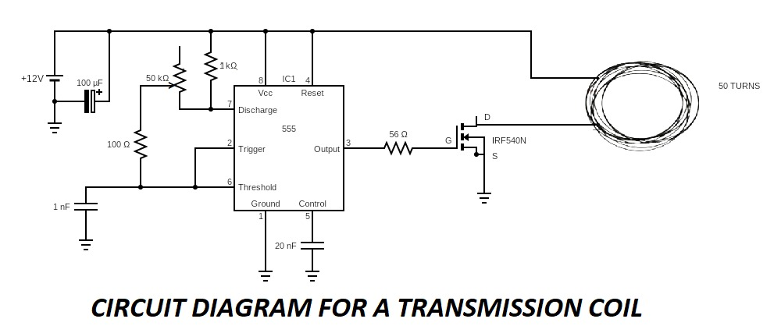
Circuit Diagram Transmission coil

Slide 8
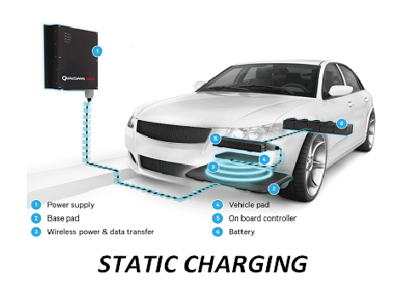
Prototype Working Static Charging

Slide 9
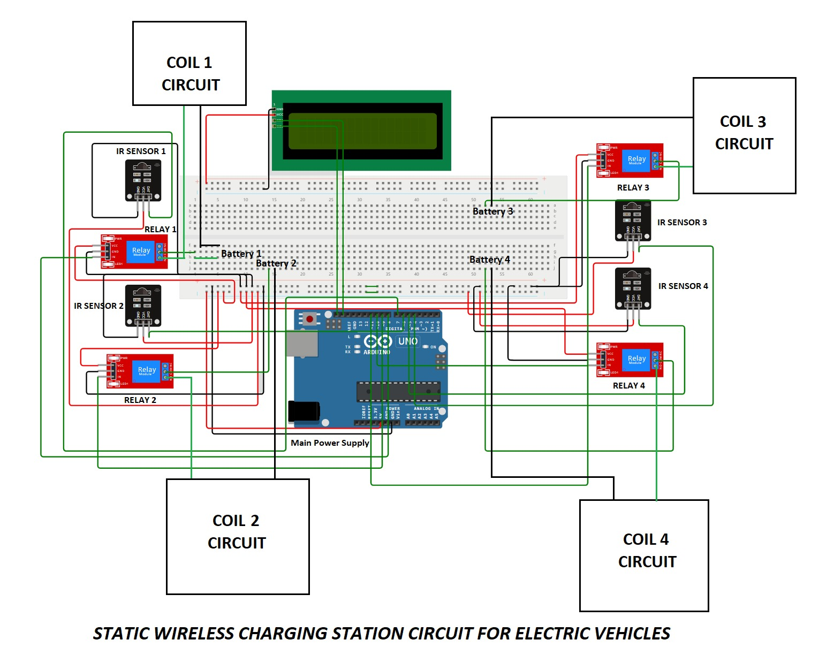
Circuit Diagram Static Charging

Slide 10
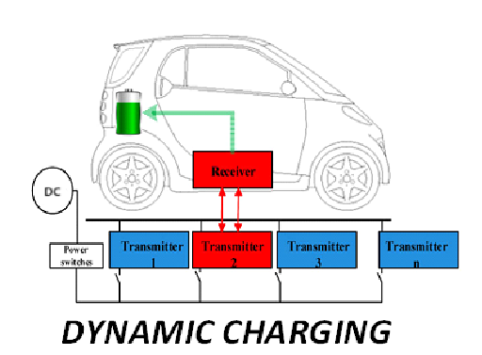
Prototype Working Dynamic Charging

Slide 11
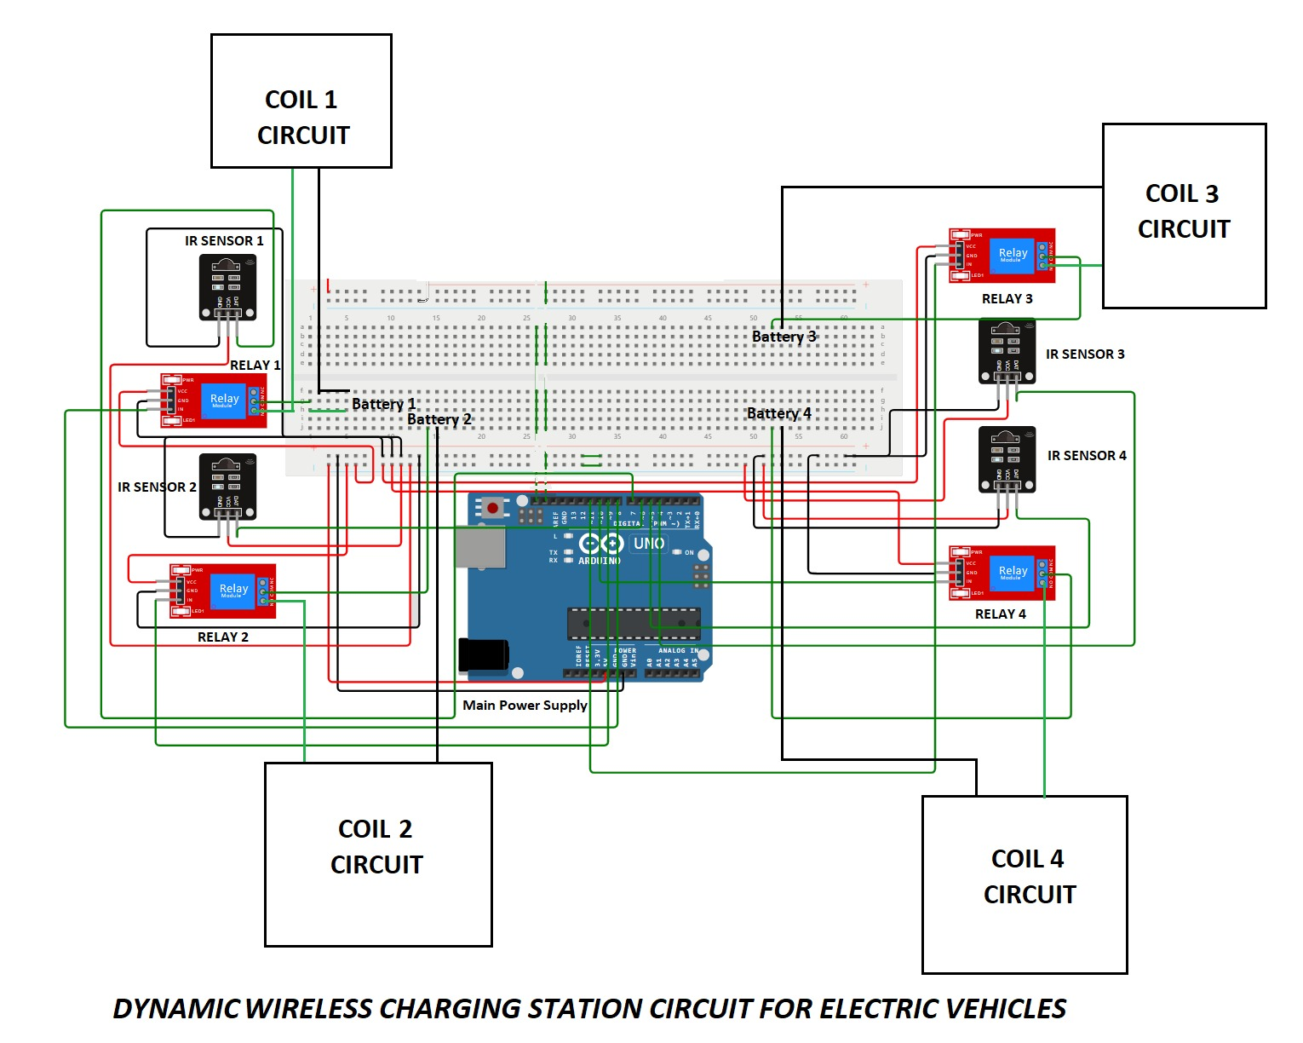
Circuit Diagram Dynamic Charging

Slide 12
Programs Implemented
Including Header Files
#include<Wire.h>
#include<LiquidCrystal_I2C.h>
LiquidCrystal_I2C lcd(0x27 , 16 , 2);

Slide 13
Arduino Code for Static Charging
int irSensorPin1 = 2; // Pin connected to take input of IR sensor
int relaypin1=6; //Pin connected to give output to Relay
unsigned long activationTime1 = 0;
unsigned long deactivationTime1 = 0;
unsigned long onTime1 = 0;
int x = 0;
float amount = 0;
int irSensorPin2 = 3; // Pin connected to take input of IR sensor
int relaypin2=7; //Pin connected to give output to Relay
unsigned long activationTime2 = 0;
unsigned long deactivationTime2 = 0;
unsigned long onTime2 = 0;
int y = 0;
int irSensorPin3 = 4; // Pin connected to take input of IR sensor
int relaypin3=8; //Pin connected to give output to Relay
unsigned long activationTime3 = 0;
unsigned long deactivationTime3 = 0;
unsigned long onTime3 = 0;
int z = 0;
int irSensorPin4 = 5; // Pin connected to take input of IR sensor
int relaypin4=9; //Pin connected to give output to Relay
unsigned long activationTime4 = 0;
unsigned long deactivationTime4 = 0;
unsigned long onTime4 = 0;
int a = 0;
Defining Variables And Pins

Slide 14
Programs Implemented
void setup()
{
pinMode (irSensorPin1, INPUT);
pinMode (irSensorPin2, INPUT);
pinMode (irSensorPin3, INPUT);
pinMode (irSensorPin4, INPUT);
pinMode (relaypin1,OUTPUT);
pinMode (relaypin2,OUTPUT);
pinMode (relaypin3,OUTPUT);
pinMode (relaypin4,OUTPUT);
digitalWrite (relaypin1,HIGH);
digitalWrite (relaypin2,HIGH);
digitalWrite (relaypin3,HIGH);
digitalWrite (relaypin4,HIGH);
Serial.begin (9600);
lcd.init();
lcd.backlight();
}
Setup Function

Slide 15
Programs Implemented
Loop Function
void loop()
{
lcd.clear();
int sensorState1 = digitalRead(irSensorPin1);
int sensorState2 = digitalRead(irSensorPin2);
int sensorState3 = digitalRead(irSensorPin3);
int sensorState4 = digitalRead(irSensorPin4);
if (sensorState1 == HIGH)
{
// Sensor Deactivated
deactivationTime1 = millis(); digitalWrite(relaypin1,HIGH);
}
else
{
// Sensor Activated
activationTime1 = millis(); digitalWrite(relaypin1,LOW);
onTime1 = activationTime1 deactivationTime1; lcd.setCursor(0,0);
lcd.print(onTime1);
lcd.setCursor(0,1);
lcd.print(" milliseconds");
x = 1; }
if(sensorState1 == HIGH && x == 1)
{
digitalWrite(relaypin1,HIGH);
lcd.setCursor(0,0);
lcd.print("Station-1 ON for");
lcd.setCursor(0,1);
lcd.print(onTime1/1000.0);
lcd.print(" seconds");
delay(5000);
lcd.clear();
lcd.setCursor(0,0);
lcd.print("Amount :");
lcd.setCursor(0,1);
amount = onTime1 * 0.0002;
lcd.print(amount);
lcd.print(" rupees");
delay(5000);
x=0;
amount = 0;
}
// Optional delay to prevent rapid toggling

Slide 16
Programs Implemented
Loop Function-Contd.
if (sensorState2 == HIGH)
{
// Sensor Deactivated
deactivationTime2 = millis(); digitalWrite(relaypin2,HIGH);
}
else
{
// Sensor Activated
activationTime2 = millis();
digitalWrite(relaypin2,LOW);
onTime2 = activationTime2 - deactivationTime2; lcd.setCursor(0,0);
lcd.print(onTime2);
lcd.setCursor(0,1);
lcd.print(" milliseconds");
y = 1;
}
if(sensorState2 == HIGH && y == 1)
{
digitalWrite(relaypin2,HIGH);
lcd.setCursor(0,0);
lcd.print("Station-2 ON for");
lcd.setCursor(0,1);
lcd.print(onTime2/1000.0);
lcd.print(" seconds");
delay(5000);
lcd.clear();
lcd.setCursor(0,0);
lcd.print("Amount :");
lcd.setCursor(0,1);
amount = onTime2 * 0.0002;
lcd.print(amount);
lcd.print(" rupees");
delay(5000);
y=0;
amount = 0;
}

Slide 17
Programs Implemented
Loop Function-Contd.
if (sensorState3 == HIGH)
{
// Sensor Deactivated
deactivationTime3 = millis(); digitalWrite(relaypin3,HIGH);
}
else
{
// Sensor Activated
activationTime3 = millis(); digitalWrite(relaypin3,LOW);
onTime3 = activationTime3 - deactivationTime3; lcd.setCursor(0,0);
lcd.print(onTime3);
lcd.setCursor(0,1);
lcd.print(" milliseconds");
z = 1;
}
if(sensorState3 == HIGH && z == 1)
{
digitalWrite(relaypin3,HIGH);
lcd.setCursor(0,0);
lcd.print("Station-3 ON for");
lcd.setCursor(0,1);
lcd.print(onTime3/1000.0);
lcd.print(" seconds");
delay(5000);
lcd.clear();
lcd.setCursor(0,0);
lcd.print("Amount :");
lcd.setCursor(0,1);
amount = onTime3 * 0.0002;
lcd.print(amount);
lcd.print(" rupees");
delay(5000);
z=0;
amount = 0;
}

Slide 18
Programs Implemented
Loop Function-Contd.
if (sensorState4 == HIGH)
{
// Sensor Deactivated
deactivationTime4 = millis(); digitalWrite(relaypin4,HIGH);
}
else
{
// Sensor Activated
activationTime4 = millis(); digitalWrite(relaypin4,LOW);
onTime4 = activationTime4 - deactivationTime3; lcd.setCursor(0,0);
lcd.print(onTime4);
lcd.setCursor(0,1);
lcd.print(" milliseconds");
a = 1;
}
if(sensorState4 == HIGH && z == 1)
{
digitalWrite(relaypin4,HIGH);
lcd.setCursor(0,0);
lcd.print("Station-4 ON for");
lcd.setCursor(0,1);
lcd.print(onTime4/1000.0);
lcd.print(" seconds");
delay(5000);
lcd.clear();
lcd.setCursor(0,0);
lcd.print("Amount :");
lcd.setCursor(0,1);
amount = onTime4 * 0.0002;
lcd.print(amount);
lcd.print(" rupees");
delay(5000);
a=0;
amount = 0;
}
delay(100);
}

Slide 19
Arduino Code for Dynamic Charging
int irSensorPin1 = 2; // Pin connected to take input of IR sensor
int relaypin1=6; //Pin coonected to give output to Relay
int irSensorPin2 = 3; // Pin connected to take input of IR sensor
int relaypin2=7; //Pin coonected to give output to Relay
int irSensorPin3 = 4; // Pin connected to take input of IR sensor
int relaypin3=8; //Pin coonected to give output to Relay
int irSensorPin4 = 5; // Pin connected to take input of IR sensor
int relaypin4=9; //Pin coonected to give output to Relay
Defining Variables And Pins

Slide 20
Programs Implemented
void setup() {
pinMode(irSensorPin1, INPUT);
pinMode(irSensorPin2, INPUT);
pinMode(irSensorPin3, INPUT);
pinMode(irSensorPin4, INPUT);
pinMode(relaypin1,OUTPUT);
pinMode(relaypin2,OUTPUT);
pinMode(relaypin3,OUTPUT);
pinMode(relaypin4,OUTPUT);
digitalWrite(relaypin1,HIGH);
digitalWrite(relaypin2,HIGH);
digitalWrite(relaypin3,HIGH);
digitalWrite(relaypin4,HIGH);
}
Setup Function

Slide 21
Programs Implemented
Loop Function
void loop() {
int sensorState1 = digitalRead(irSensorPin1);
int sensorState2 = digitalRead(irSensorPin2);
int sensorState3 = digitalRead(irSensorPin3);
int sensorState4 = digitalRead(irSensorPin4);
if (sensorState1 == LOW) {
// Sensor Activated
digitalWrite(relaypin1,LOW);
}
else {
// Sensor Deactivated
digitalWrite(relaypin1,HIGH);
}
if (sensorState2 == LOW) {
// Sensor Activated
digitalWrite(relaypin2,LOW);
}
else {
// Sensor Deactivated
digitalWrite(relaypin2,HIGH);
}
if (sensorState3 == LOW) {
// Sensor Activated
digitalWrite(relaypin3,LOW);
}
else {
// Sensor Deactivated
digitalWrite(relaypin3,HIGH);
}
if (sensorState4 == LOW) {
// Sensor Activated
digitalWrite(relaypin4,LOW);
}
else {
// Sensor Deactivated
digitalWrite(relaypin4,HIGH);
}
}

Slide 22
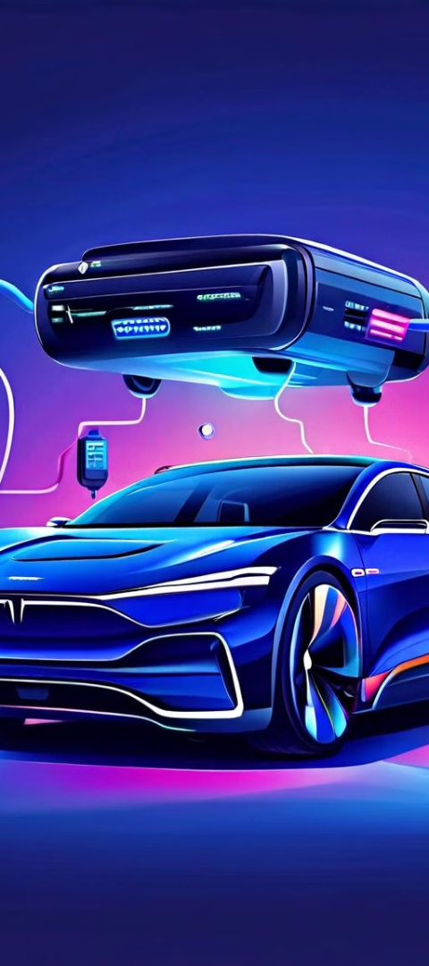
Applications
Static Charging
Residential Charging: Static wireless charging can be used at home for convenient overnight charging of electric vehicles. EV owners can park their vehicles over a wireless charging pad installed in their garage or driveway, eliminating the need to plug and unplug the charging cable manually.
Real-life Application many students making electrical car for their project but have charging port , we by using WL-CEV give them a way to charging their prototypes.
Fleet Charging: For fleets of electric vehicles, such as taxis, delivery vehicles, or buses, static wireless charging can offer operational efficiency. Vehicles can be charged automatically whenever they are parked at designated charging spots, reducing downtime and ensuring they are always ready for service.
Public Infrastructure: Wireless charging infrastructure can be installed in public spaces such as parking lots, streets, and public transportation hubs. This allows EV drivers to top up their vehicles' batteries while parked without the hassle of finding and connecting to a charging station manually..
Emergency Charging: In emergency situations where power outages or infrastructure damage occur, static wireless charging can provide a backup charging solution for electric vehicles, ensuring mobility even during challenging circumstances.
Integration with Renewable Energy: Wireless charging systems can be integrated with renewable energy sources such as solar panels or wind turbines. This enables EVs to be charged using clean energy, contributing to sustainability goals and reducing carbon emissions.

Slide 23
Applications
Dynamic Charging
Electric Roads and Highways: Dynamic wireless charging can be implemented on roads and highways to enable EVs to charge while driving. This technology involves embedding charging infrastructure directly into the road surface, allowing vehicles equipped with compatible receivers to replenish their batteries as they travel.
Public Transportation Systems: Dynamic wireless charging can benefit public transportation systems, such as electric buses or trams. By integrating wireless charging technology into bus lanes or tram tracks, public transit vehicles can charge continuously during their routes, reducing the need for frequent stops for recharging.
Logistics and Freight Transportation: Dynamic wireless charging is advantageous for logistics and freight transportation fleets. Trucks, delivery vehicles, and other commercial vehicles can charge while on the move, minimizing downtime and ensuring efficient operations for long-distance journeys.
Autonomous Vehicle Integration: Dynamic wireless charging is well-suited for autonomous vehicles (AVs) as it allows them to recharge their batteries without human intervention. AVs can navigate designated charging lanes or areas equipped with dynamic charging infrastructure, optimizing their energy consumption and range.
Public Infrastructure Integration: Dynamic wireless charging infrastructure can be integrated with existing public infrastructure, such as traffic signals, streetlights, and parking facilities. This integration maximizes the utilization of space and resources while providing convenient charging options for EV users.

Slide 24
Benefits
Reducing Range Anxiety: Constant connection to a wireless electric vehicle charging system helps alleviate range anxiety by maintaining the battery in an optimal state of charge.
Efficient Network Management: Continuous connection aids in managing the power demand from electric vehicles, preventing spikes that strain the utility network.
Utility Infrastructure Optimization: Traditional utility infrastructure is designed based on historical consumption patterns, often underestimating the demand from electric vehicles.
Transformer Overload Mitigation: Electric vehicles can demand more power than the infrastructure is designed for, potentially overloading street transformers.
Infrastructure Upgrade Avoidance: Constant connection and better management of electric vehicle charging can minimize the need for costly upgrades to utility infrastructure.
Nighttime Demand Reduction: By managing charging throughout the day, demand during nighttime charging periods can be minimized.
Wireless Charger Benefits: Wireless home chargers can be more affordable and compact, operating to top up the battery efficiently.

Slide 25
Challenges
To install static and dynamic wireless charging stations on the roads, new infrastructure development is required as current arrangement are not suitable for the installations.
Need to maintain the EMC, EMI and frequencies as per standards for the human Health and safety concern.

Slide 26
Limitations
Efficiency: Wireless charging is generally less efficient than wired charging. Energy is lost during the transfer due to electromagnetic induction, resonant coupling, and other factors. This inefficiency can lead to longer charging times and higher energy costs.
Cost: The infrastructure required for wireless charging, such as charging pads and power electronics, can be expensive to install and maintain. This cost can be a significant barrier, especially for widespread deployment in public spaces or large-scale adoption.
Power and Speed: Current wireless charging systems often have lower power output compared to wired charging, which means they may not be suitable for fast charging or high-capacity batteries. This limitation can be a drawback for EVs that require quick recharge times.
Interoperability: There is currently no universal standard for wireless charging in the EV industry. Different manufacturers may use proprietary technologies or standards, leading to compatibility issues and limiting interoperability between charging stations and vehicles.
Heat Generation: Wireless charging systems can generate heat during operation, which may affect the efficiency of charging and potentially impact the lifespan of batteries if not managed properly.

Slide 27
Currently Working
Evatran group's
Qualcomm Halo
Hevo Power
making Plugless Charging for passenger EVs like Tesla Model S, BMW i3, Nissan Leaf, Gen 1 Chevrolet Volt.
is making WCS for Passenger, sport and race car and it is acquired by Witricity corporation.
is making WCS for Passenger car
Bombardier Primove
Siemens and BMW
Momentum Dynamic
is making WCS for Passenger car.
is making WCS for Passenger car to SUVs.
is making WCS Corporation Commercial fleet and Bus.
Conductix-Wampfler
is making WCS for Industry fleet and Bus.

Slide 28
END
THANK YOU

